Slide 1
WIRELESS LOCALIZATION USING SELF-ORGANIZING MAPS
Milan Branković
University of Belgrade
School of Electrical Engineering
Department of Computer Science

Slide 2
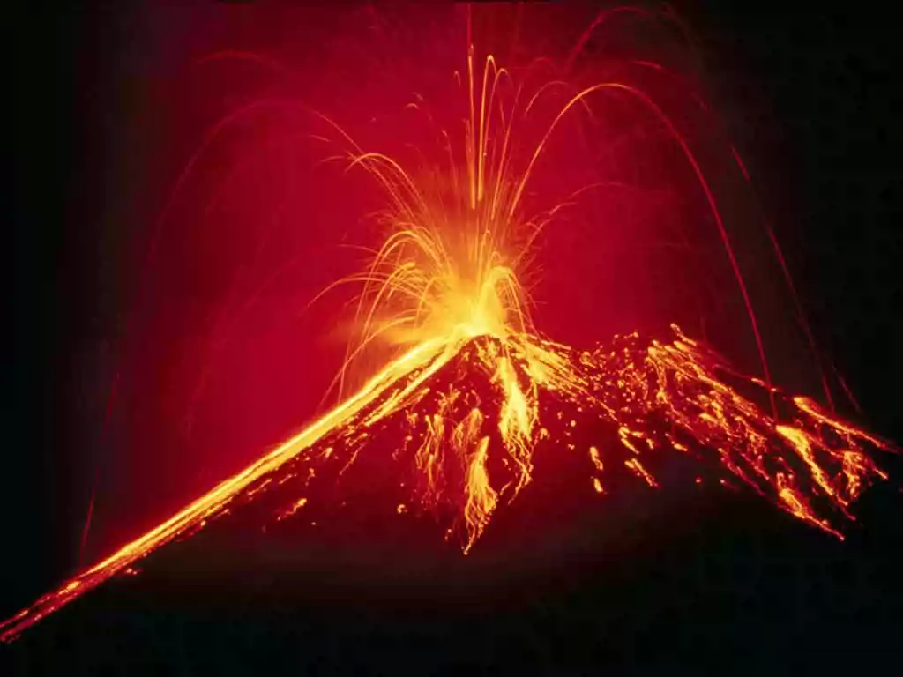
THE PROBLEM
Monitoring of environments like: head of an active volcano, difficult terrain border lands, bridges, battlefields, roads, sluices etc.

Slide 3
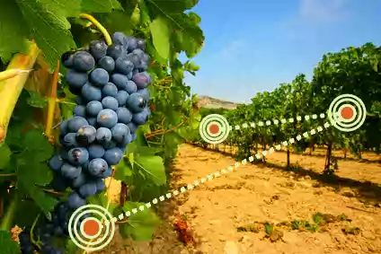
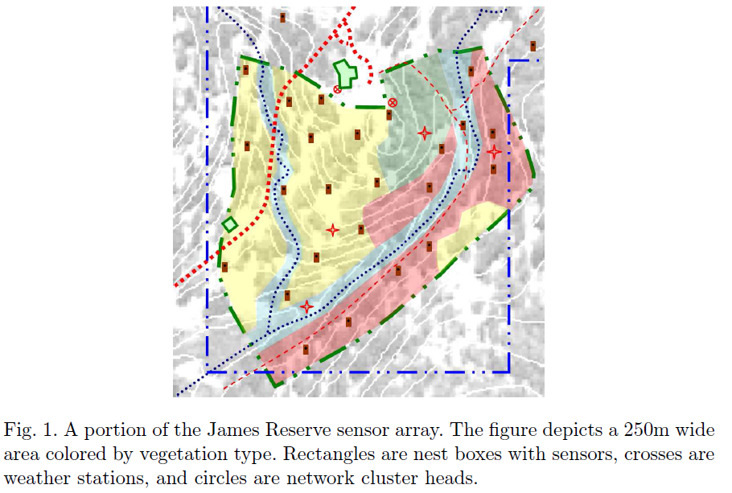
THE PROBLEM
Wireless sensor networks (WSNs) have been recently deployed in many areas of agriculture to increase yield and prevent outbreaks
These applications rely mainly on manually measuring and controlling parameters such as moisture, temperature, pH, oxygen, etc., which are both time consuming and laborious

Slide 4
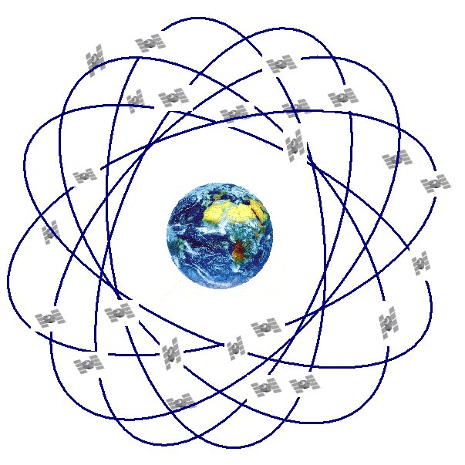

PROBLEM IMPORTANCE
Localization is an essential service for many wireless sensor network applications
Position-awareness is rapidly becoming a key feature in many applications(GPS)
System that adapts to achieve a goal more efficiently

Slide 5

PROBLEM IMPORTANCE
Environmental monitoring, asset tracking, surveillance and disaster relief
Limited power, low radio range, potentially high density, and ever changing environment all push for a distributed and adaptive solution
Minimal communication overhead without needing any additional hardware

Slide 6
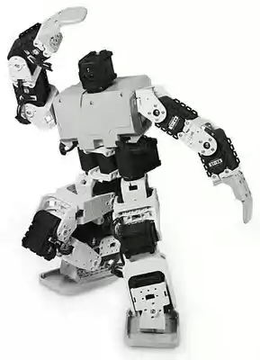
PROBLEM TREND
Used to implement localization schemes for mobile robots in unknown environments
Becoming a reality in residential, commercial, medical, industrial and military applications
Biological Models
Social Models (swarm)
Economic Models
Other Models
Pattern recognition
Robotics
Speech recognition

Slide 7
EXISTING SOLUTION
Biological Background: Lateral Inhibition and Hebbian Learning
Biological basis: ‘brain maps’
From Von Marsburg and Willshaw’s Self-Organization Model to Kohonen’s SOM
Hebb’s learning law (1949)
Marr’s theory of the cerebellar cortex (1969)
Willshaw, Buneman and Longnet-Higgins’s non-holographic associative memory (1969)
Gaze’s studies on nerve connections (1970),
von der Malsburg and Willshaw’s self-organizing model of retina-cortex mapping
Amari’s mathematical analysis of self-organization in the cortex (1980),
Kohonen’s self-organizing map (1982),
and Cottrell and Fort’s self-organizing model of retinotopy (1986)

Slide 8


EXISTING SOLUTION
Self-organizing power of these early models was rather weak
Allowing devices to reconnoiter their surroundings, cooperate to form topologies, and monitor and adapt to environmental changes, all without human intervention
SOMs are unique because the neurons are arranged in regular geometric structures, typically two-dimensional lattices with rectangular or hexagonal patterns

Slide 9
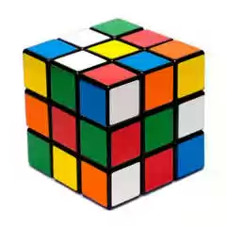

EXISTING SOLUTION
Self-organizing systems can solve problems that are unsolvable using other techniques
Even for problems with known solutions, self-organizing systems can devise innovative approaches that might otherwise go undiscovered
Exhibit the principle of least action, which tends to minimize distance to an optimal (stable) state, and thus prove efficient at solving difficult optimization problems

Slide 10
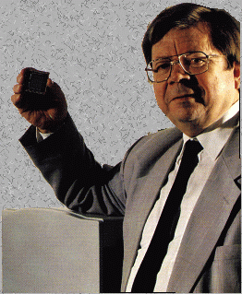
Self-Organizing Map (SOM)
Self-Organizing Map was developed by professor Kohonen
One of the most popular neural network models
Based on a neural network formalism
Belongs to the category of competitive learning networks
Based on unsupervised learning
Performs the grouping on its own

Slide 11
SOM Structure
Two layers of units
Input: n units (length of training vectors)
Output: m units (number of categories)
Input units fully connected with weights to output units
Intra-layer (“lateral”) connections
Within output layer
Defined according to some topology
No weight between these connections, but used in algorithm for updating weights
The network can be represented as an undirected graph, where two vertices are connected if the corresponding nodes are radio neighbors

Slide 12
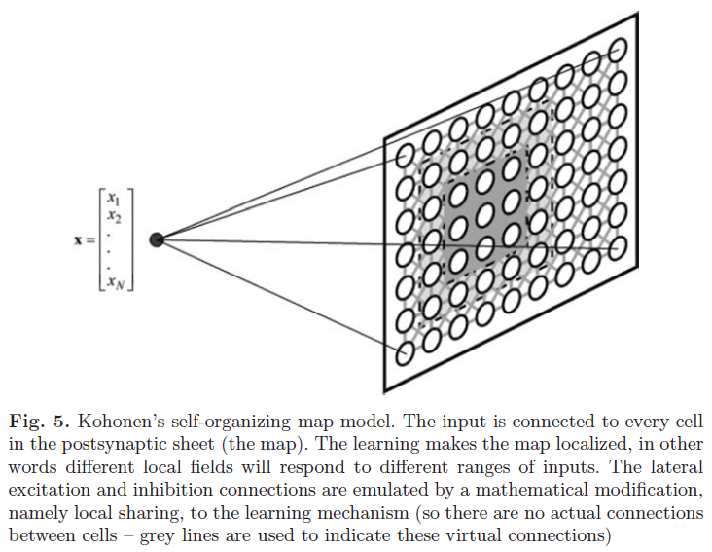
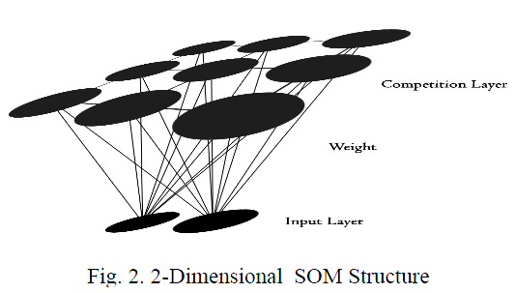
SOM Structure
Every node is connected to the input the same way, and no nodes are connected to each other
Notes:
It consists of an input layer connected to a output layer (Two-dimensional Kohonen layer) via a Kohonen Connector consisting of Kohonen Synapses. Each neuron in a Kohonen Layer is associated with a unique set of co-ordinates in two-dimensional space, and hence is referred to as a Position Neuron. The input layer with 'n' input neurons is fed with n-dimensional input data one by one. The output layer organizes itself to represent the inputs. Hence the name 'self-organizing map'.

Slide 13
Overall SOM Algorithm
Training
Select output layer topology (e.g. rectangular map)
Train weights connecting inputs to outputs
Topology is used, in conjunction with current mapping of inputs to outputs, to define which weights will be updated
Distance measure using topology is reduced over time; reduces the number of weights that get updated per iteration
Learning rate is reduced over time
Testing
Use weights from training

Slide 14
SOM – Algorithm Overview
Randomly initialize each node’s weights
Choose a random vector V = [V₁, V₂, V₃, … , V_{n}] from training data and present it to the SOM
Determine winner. Every node is examined to find the Best Matching Unit (BMU)
The radius of the neighborhood around the BMU is calculated. The size of the neighborhood decreases with each iteration
Adjust parameters: learning rate & ‘neighbourhood function’. Each node in the BMU’s neighborhood has its weights adjusted to become more like the BMU. Nodes closest to the BMU are altered more than the nodes furthest away in the neighborhood
Repeat from step 2 for enough iterations for convergence or pre-defined no. of training cycles have passed

Slide 15
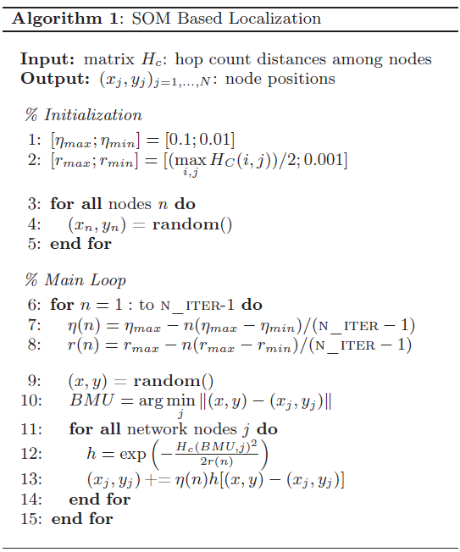
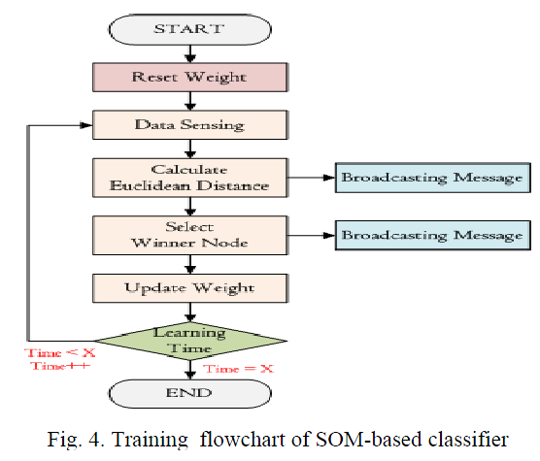
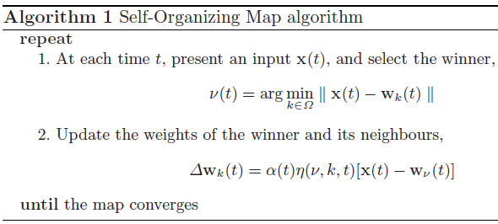
SOM – Algorithm Overview

Slide 16
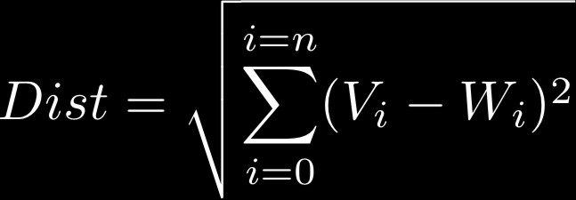
Calculating the Best Matching Unit
Calculating the BMU is done according to the Euclidean distance among the node’s weights (W₁, W₂, … , W_{n}) and the input vector’s values (V₁, V₂, … , V_{n})
This gives a good measurement of how similar the two sets of data are to each other

Slide 17


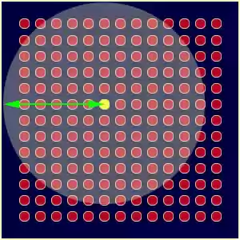
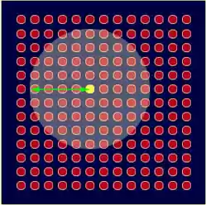
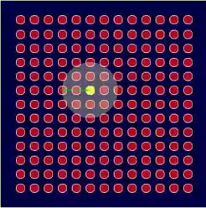
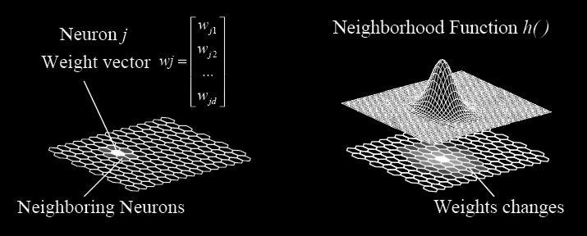

Determining the BMU Neighborhood
Size of the neighborhood: We use an exponential decay function that shrinks on each iteration until eventually the neighborhood is just the BMU itself
Effect of location within the neighborhood: The neighborhood is defined by a Gaussian curve so that nodes that are closer are influenced more than farther nodes

Slide 18

Modifying Nodes’ Weights
The new weight for a node is the old weight, plus a fraction (L) of the difference between the old weight and the input vector adjusted (theta) based on distance from the BMU
The learning rate, L, is also an exponential decay function
This ensures that the SOM will converge
The lambda represents a time constant, and t is the time step

Slide 19
EXAMPLE (1)
Example I: Learning a one-dimensional representation of a two-dimensional (triangular) input space:
0
20
25000
100
1000
10000

Slide 20
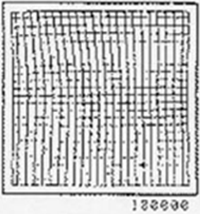
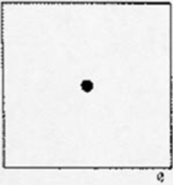
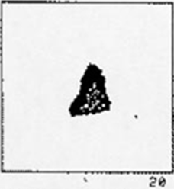
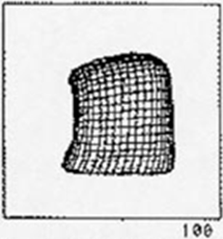
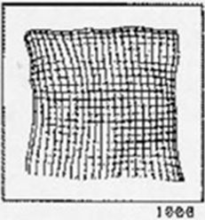
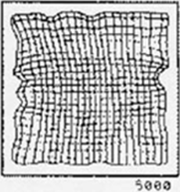
EXAMPLE (2)
Example II: Learning a two-dimensional representation of a two-dimensional (square) input space:

Slide 21
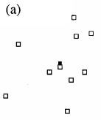
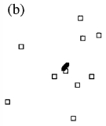
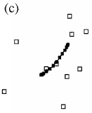
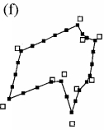
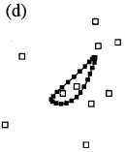
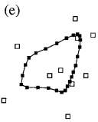
EXAMPLE (3)

Slide 22
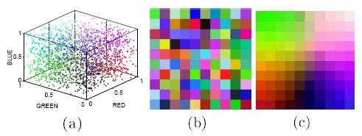
EXAMPLE (4)
http://www.ai-junkie.com/files/SOMDemo.zip
Input space
Initial weights
Final weights
http://www.ai-junkie.com/files/KirkD_SOM.zip
http://www.cs.usyd.edu.au/~irena/ai01/nn/somapplet.htm

Slide 23
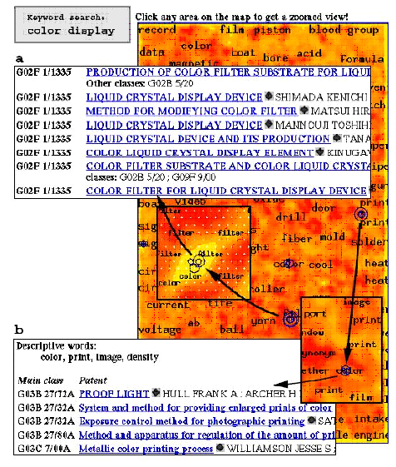
CURRENT APPLICATION (1)
WEBSOM: Organization of a Massive Document Collection

Slide 24
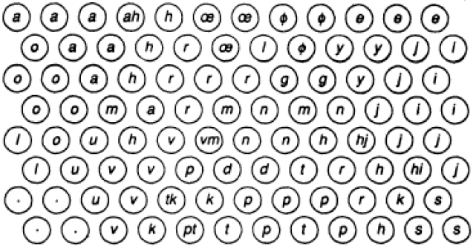
CURRENT APPLICATION (2)
Phonetic Typewriter

Slide 25
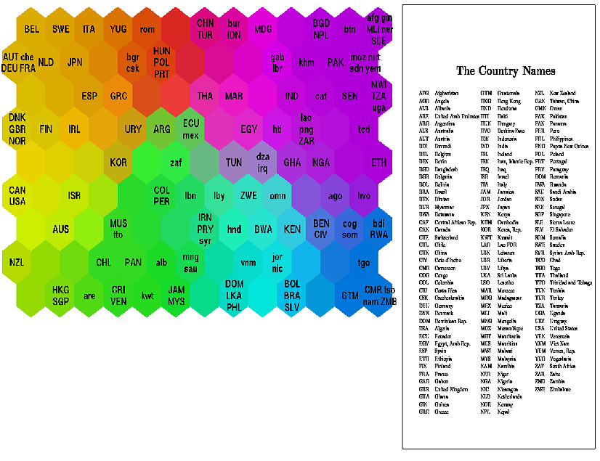
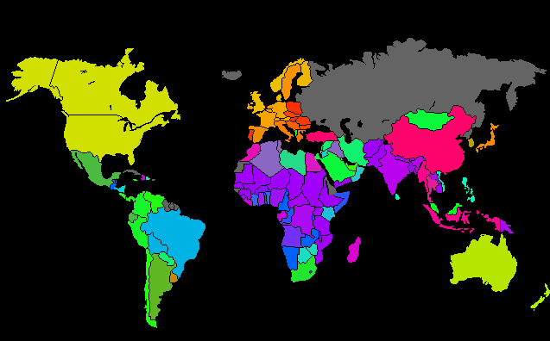
CURRENT APPLICATION (3)
Classifying World Poverty
Notes:
A SOM has been used to classify statistical data describing various quality-of-life factors such as state of health, nutrition, educational services etc. . Countries with similar quality-of-life factors end up clustered together. The countries with better quality-of-life are situated toward the upper left and the most poverty stricken countries are toward the lower right. The hexagonal grid is a unified distance matrix, commonly known as a u-matrix. Each hexagon represents a node in the SOM.

Slide 26
CONCLUSIONS
SOM is a biologically inspired neural network for high dimensional data clustering and visualization
Its most important property is topology preservation
There are several variants or extensions, which tends to overcome the limitations of the SOM
There are a number of successful applications of SOM
Dividing of network nodes into several clusters while cluster head of each cluster play the role of a local base station
Prediction of sensor measurements (reducing communications)

Slide 27

Q&A
Thank you
for your attention!

